Slide 1
NoSQL Data Models

Slide 2
Features of NoSQL
Schema Agnostic: NoSQL Databases do not require any specific schema or s storage structure than traditional RDBMS.
Scalability: NoSQL databases scale horizontally as data grows rapidly certain commodity hardware could be added and scalability features could be preserved for NoSQL.
Performance: To increase the performance of the NoSQL system one can add a different commodity server than reliable and fast access of database transfer with minimum overhead.
High Availability: In traditional RDBMS it relies on primary and secondary nodes for fetching the data, Some NoSQL databases use master place architecture.
Global Availability: As data is replicated among multiple servers and clouds the data is accessible to anyone, this minimizes the latency period.

Slide 3
Aggregate Model
For the people who interact with data in databases, the Aggregate Data model will help in that interaction.
The term aggregate means a collection of objects that we use to treat as a unit.
An aggregate is a collection of data that we interact with as a unit. These units of data or aggregates form the boundaries for ACID operation.

Slide 4
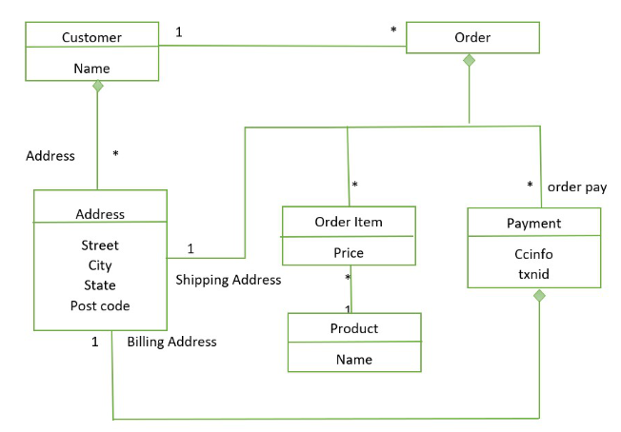
Customer and Orders link between them represent an aggregate.
The diamond shows how data fit into the aggregate structure.
Customer contains a list of billing address
Payment also contains the billing address
The address appears three times and it is copied each time
The domain is fit where we don’t want to change shipping and billing address.

Slide 5
Advantages and Disadvantages of Aggregate Model
Advantage:
It can be used as a primary data source for online applications.
Easy Replication.
No single point Failure.
It provides fast performance and horizontal Scalability.
It can handle Structured semi-structured and unstructured data with equal effort.
Disadvantage:
No standard rules.
Limited query capabilities.
Doesn’t work well with relational data.
Not so popular in the enterprise.
When the value of data increases it is difficult to maintain unique values.

Slide 6
Columnar Data Model
NoSQL databases are a flexible schema model which is designed to scale horizontally across many servers and is used in large volumes of data.
Basically, the relational database stores data in rows and also reads the data row by row, column store is organized as a set of columns.
So if someone wants to run analytics on a small number of columns, one can read those columns directly without consuming memory with the unwanted data.
Columns are somehow are of the same type and gain from more efficient compression, which makes reads faster than before.
Examples of Columnar Data Model: Cassandra and Apache Hadoop Hbase.
In Columnar Data Model instead of organizing information into rows, it does in columns.
This makes them function the same way that tables work in relational databases.
This type of data model is much more flexible obviously because it is a type of NoSQL database.
Columnar Data Model uses the concept of keyspace, which is like a schema in relational models.

Slide 7
Document Data Model
A document database is a type of NoSQL database which stores data as JSON documents instead of columns and rows.
JSON is a native language used to both store and query data.
These documents can be grouped together into collections to form database systems.
Data is stored in documents (unlike other databases that store data in structures like tables or graphs).
Documents map to objects in most popular programming languages, which allows developers to rapidly develop their applications.

Slide 8
Key Value Data Model
A key-value database (also known as a key-value store) is a type of noSQL database.
Unlike prior relational databases that stored data in defined tables and columns, a key-value database instead uses individual or combinations of keys to retrieve associated values.
Together they are known as key-value pairs.
A key-value database is a type of nonrelational database that uses a simple key-value method to store data.
A key-value database stores data as a collection of key-value pairs in which a key serves as a unique identifier.
Both keys and values can be anything, ranging from simple objects to complex compound objects.
The examples of key-value stores are: Amazon dynamo, memcachedb, voldemort, redis and riak

Slide 9
Graph Based Data Model
Graph Based Data Model in NoSQL is a type of Data Model which tries to focus on building the relationship between data elements
A graph-based model is a model based on graph theory.
Testing an application can be viewed as traversing a path through the graph of the model.
Graph theory techniques therefore allow us to use the behavioral information stored in models to generate new and useful tests.
Some examples of Graph Databases software are Neo4j, Oracle NoSQL DB, Graph base etc

